Slide 1
Net Input Price Indexes – Accounting for Imports in the Cost of Production
Federal Economic Statistics Advisory Committee
December 11, 2020
Susan E. Fleck, PhD
Office of Prices and Living Conditions
U.S. Bureau of Labor Statistics

Slide 2
INTRODUCTION

Slide 3
GDP = C + I + G + X - M
Domestic Price Change
Final Demand Producer Price Indexes
C, I, G, X
Used to deflate outputs of businesses
Adjusts for price change of domestic production output

Slide 4
GDP = C + I + G + X – M
Price Change of Traded Goods
Export and Import Price Indexes
X, M
Used to deflate exports and imports that comprise Net Trade

Slide 5
Intermediate Demand Measures Inputs into Domestic Production
Domestic and Import Price Change
Commodity Producer Price Indexes
E, M, S
Used to deflate cost of inputs into U.S. production
Import Price Indexes

Slide 6
Net Input Price Indexes Based on Detailed Products
Input | Energy | Materials | Services
Domestic
Import

Slide 7
Net Input Price Indexes Publication Format
Input | Goods | Services | Construction
Domestic
Import

Slide 8
What Do Industry Net Input Price Indexes Offer
Relevant, reliable, and accessible
Parse out imported intermediates by domestic use in greater detail than other intermediate input price indexes.
Use unpublished BLS detailed price indexes
Posted monthly
Break out by Domestic/Import, Goods/Service

Slide 9
HISTORICAL CONTEXT

Slide 10
Brief History
Something Old
Domestic Net Input Price Indexes
Something New
Import Price Indexes
Something Borrowed
Alterman et al

Slide 11
Brief History
Something Blue
Does not address the critiques of sourcing substitution bias

Slide 12
2007 Redux – Import Price Indexes in the News

Slide 13
2007 Redux – Globalization and U.S. Statistics
$1 million budget proposal
Do statistical measure of the United States economy correctly interprets the impact of imports and outsourced production;
Do statistical measures of the United States economy result in an accurate report of United States gross domestic product (GDP), productivity, and other aspects of economic performance;
Is the impact of imports on United States manufacturing levels and competitiveness accurately reported; and
Do the methods used for accounting for imported goods and United States wages result in overstating economic growth, domestic manufacturing output, and productivity growth?
What actions should be taken to produce more accurate import price indices on a regular basis; and
What other measures of economic analysis should be used to accurately reflect the globalization of economic activity and offshoring of domestic production?

Slide 14
Offshoring Price Index Bias Example
 | M 1 | M 2 | M 3 | M 4 | M 5 | M 6
Chair A - Domestic | $10 | $10 | $10 | $10 | $10 | $10
Chair B - Domestic | $10 | $10 | - | - | - | -
Chair B - Imported | - | - | $5 | $5 | $5 | $5
Chair C - Domestic | $10 | $10 | $10 | $10 | - | -
Chair C - Imported | - | - | - | - | $5 | $5
Chair D - Imported | $5 | $5 | $5 | $5 | $5 | $5
Producer Price Index | 100.0 | 100.0 | 100.0 | 100.0 | 100.0 | 100.0
Import Price Index | 100.0 | 100.0 | 100.0 | 100.0 | 100.0 | 100.0
Net Input Price Index | 100.0 | 100.0 | 100.0 | 100.0 | 100.0 | 100.0
Buyer’s Input Price Index | 100.0 | 100.0 | 85.7 | 85.7 | 71.4 | 71.4

Slide 15
New Net Input Price Index on Balance
Responds to industry data user needs
Based on official PPIs and MPIs
Updated Monthly with PFEIs
Cost effective
Fair proxy of a buyer’s price index
Does not address sourcing substitution bias
Excludes labor and capital investment
Does not account for imported services
Excludes domestically produced services where no PPI is published

Slide 16
DETAILS

Slide 17
Net Input Price Index – Example of Relative Importance, Dec 2019
IN337 | Inputs to 337, furniture and related product manufacturing, excl capital investment and labor | 100.000
IN3371 | Inputs to 337, domestically produced products | 86.562
IN33711 | Inputs to 337, domestically produced goods | 57.751
PPI-091503 | Paper boxes and containers | 3.103
PPI-072304 | Laminated plastics plates, sheet (excluding packaging), and shapes | 2.941
PPI-092201 | Particleboard and fiberboard | 2.406
PPI-081106 | Softwood lumber, not edge worked | 2.328
IN33712 | Inputs to 337, domestically produced services | 28.812
PPI-576101 | Paper and plastics products wholesaling | 5.668
PPI-573101 | Building materials, paint, and hardware wholesaling | 3.591
PPI-572101 | Furnishings wholesaling | 2.424
IN3372 | Inputs to 337, imported goods | 13.438
MPI-337215 | Showcase, partition, shelving, and locker manufacturing | 2.228

Slide 18
Net Input Price Index – Example of Relative Importance, Dec 2019
IN337 | Inputs to 337, Furniture and related product manufacturing, excl capital investment and labor | 100.000
IN3371 | Inputs to 337, domestically produced products | 86.562
IN33711 | Inputs to 337, domestically produced goods | 57.751
PPI-091503 | Paper boxes and containers | 3.103
PPI-072304 | Laminated plastics plates, sheet (excluding packaging), and shapes | 2.941
PPI-092201 | Particleboard and fiberboard | 2.406
PPI-081106 | Softwood lumber, not edge worked | 2.328
IN33712 | Inputs to 337, domestically produced services | 28.812
PPI-576101 | Paper and plastics products wholesaling | 5.668
PPI-573101 | Building materials, paint, and hardware wholesaling | 3.591
PPI-572101 | Furnishings wholesaling | 2.424
IN3372 | Inputs to 337, imported goods | 13.438
MPI-337215 | Showcase, partition, shelving, and locker manufacturing | 2.228
97 PPIs
47 PPIs
26 MPIs

Slide 19
Attributes of Combined Input Indexes
OPLC Net Input Price Indexes
OPT Combined Input Intermediate Price Index
BEA Intermediate Input Price Index
Industry Inputs exc. intraindustry transactions
Business
Approximately 3-digit NAICS
Dec 2018 onward
Monthly (NSA)
Modified Laspeyres
Inputs to sectoral output
Private Business
Approximately 3-digit NAICS
1987 onward
Annual
Tornquist
Inputs to gross output
Total economy
Approximately 3-digit NAICS
1947 onward, Annual; 2005Q1 onward, Quarterly (SA)
Fisher

Slide 20
2019Q1=100

Slide 21
2019Q1=100

Slide 22
2019Q1=100

Slide 23
Relevance of Net Input Price Indexes
Industry level analysis
Price transmission analysis
Deflation of industries with no marketable output (ie social assistance)
Contract price adjustment
Deflation of inputs to domestic production

Slide 24
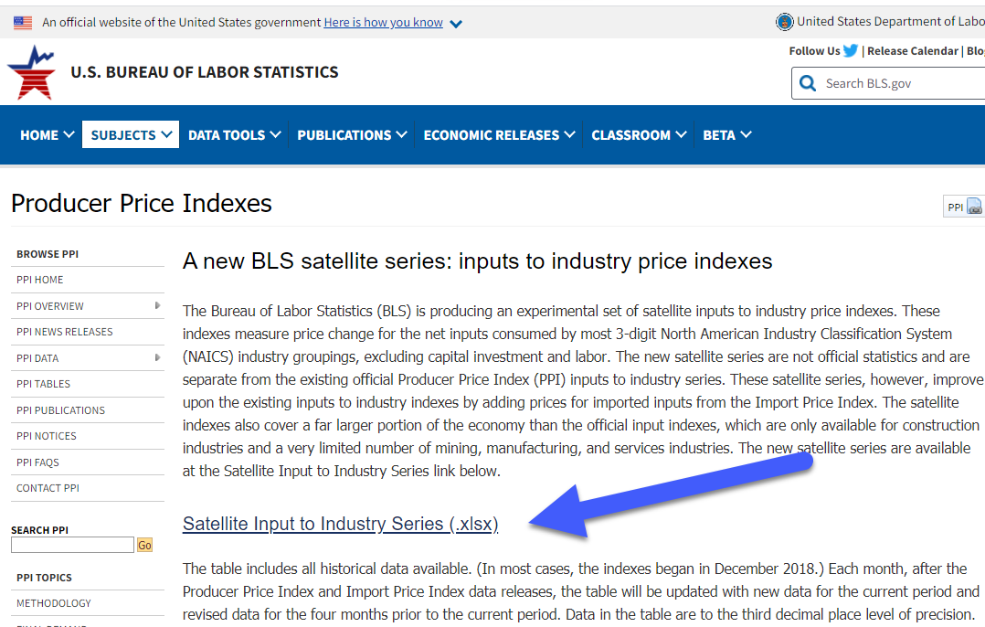
Where to Find the Net Input Price Indexes
Website: https://www.bls.gov/ppi/a-new-bls-satellite-series-inputs-to-industry-price-indexes.htm
Article: https://www.bls.gov/opub/mlr/2015/article/new-ppi-net-inputs-to-industry-indexes.htm

Slide 25
Next Steps
Collect feedback: Satellite_Series_Feedback@bls.gov
Compare with other intermediate input price index measures
Evaluate resources required to publish at different levels of detail (4-digit NAICS, NIPA, grouping by E-M-S)
Evaluate proposed improvements to MPIs using administrative trade data to mitigate new goods and country substitution bias for imported intermediates

Slide 26
Thank you
And thanks to the Producer Price Index and Import/Export Price Index staff for their work over the past four years to develop the approach for this new data product.

Slide 27
Methodology: weights – domestic inputs
${DomesticWeight}_{c,i}={Use}_{c,i}/(\sum_{i=1}^{n}{{Use}_{c,i})∗{WEMVOS}_{c} }$
where
${Domestic Weight}_{c,i}$ refers to the domestically produced weight of commodity c in the input index for industry i
${Use}_{c,i}$ refers to use of commodity c by the industry i
$\sum_{i=1}^{n}{{Use}_{c,i}}$ is the total use of commodity c by all 1 through n industries included in the use table
${WEMVOS}_{c}$is the domestic wherever-made value of shipments for commodity c.

Slide 28
Methodology: weights – imported inputs
${Import Weight}_{c,i}={Use}_{c,i}/(\sum_{i=1}^{n}{{Use}_{c,i})∗{VOI}_{c} }$
where
${Import Weight}_{c,i}$ refers to the foreign produced weight of commodity c in the input index for industry i
${Use}_{c,i}$ refers to use of commodity c by the industry i
$\sum_{i=1}^{n}{{Use}_{c,i}}$ is the total use of commodity c by all 1 through n industries included in the use table
${VOI}_{c}$is the value of imports for commodity c.

